Slide 1
REPORT OF UKPAGADA 2023 ANNUAL LECTURESHIP
Mike Udam
Servant of the church

Slide 2
SUMMARY OF THE REPORT
5 DAYS OF INTENSE SPIRITUAL EXERCISE
3 DAYS OF AGGRESSIVE EVANGELISM
9 SOULS WON TO CHRIST
503 PARTICIPANTS DURING THE INDOOR LECTURESHIP
58 CONGREGATIONS ACROSS NIGERIA PARTICIPATED
SONG FELLOWSHIP
FOOD FELLOWSHIP (SWALLOWSHIP)
TRACTS AND BIBLE DISTRIBUTION

Slide 3
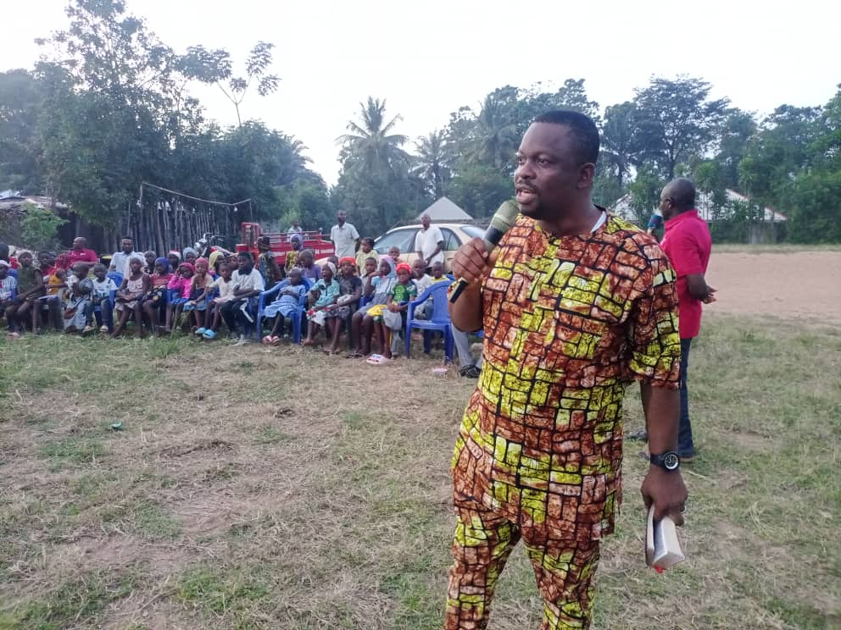
EVANGELISM AT ALLADIM
TUBOBELEM WEST SPEAKING

Slide 4
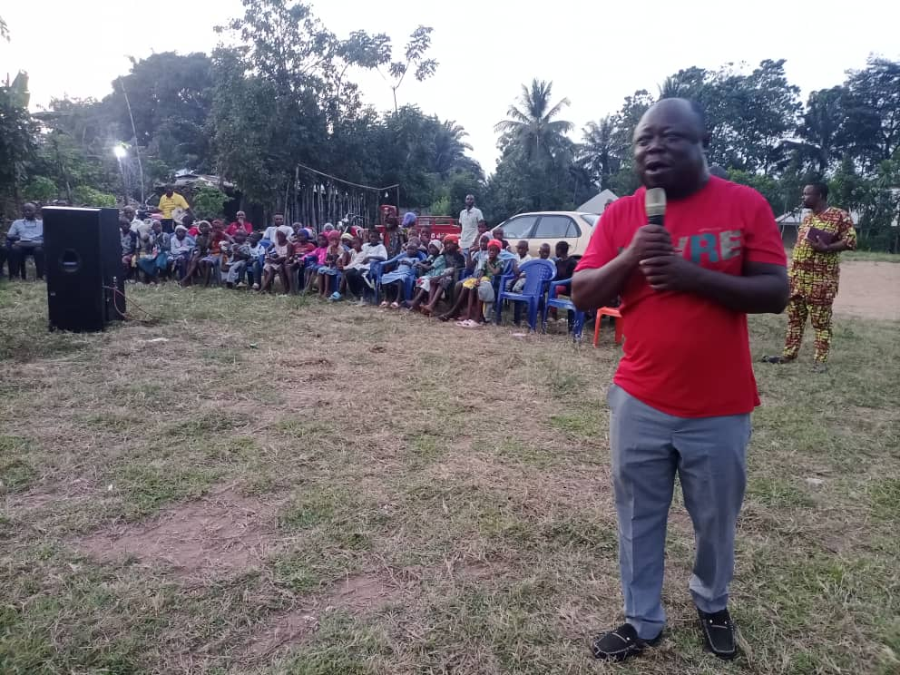
EVANGELISM AT ALLADIM
MIKE UDAM SPEAKING

Slide 5
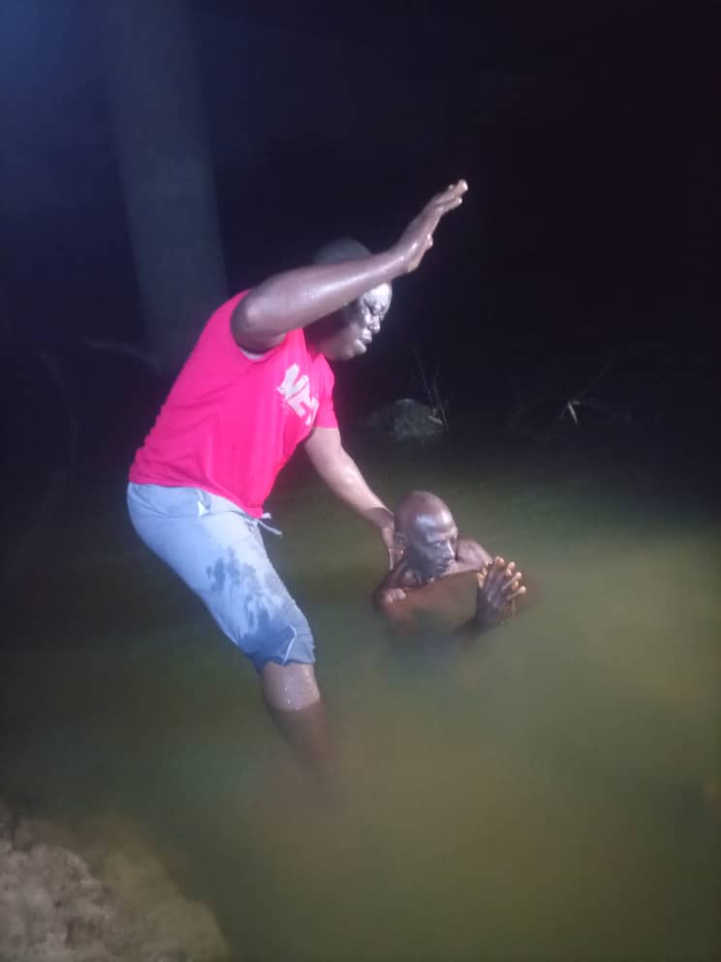
EVANGELISM AT ALLADIM
BAPTISM EVEN AT NIGHT.

Slide 6
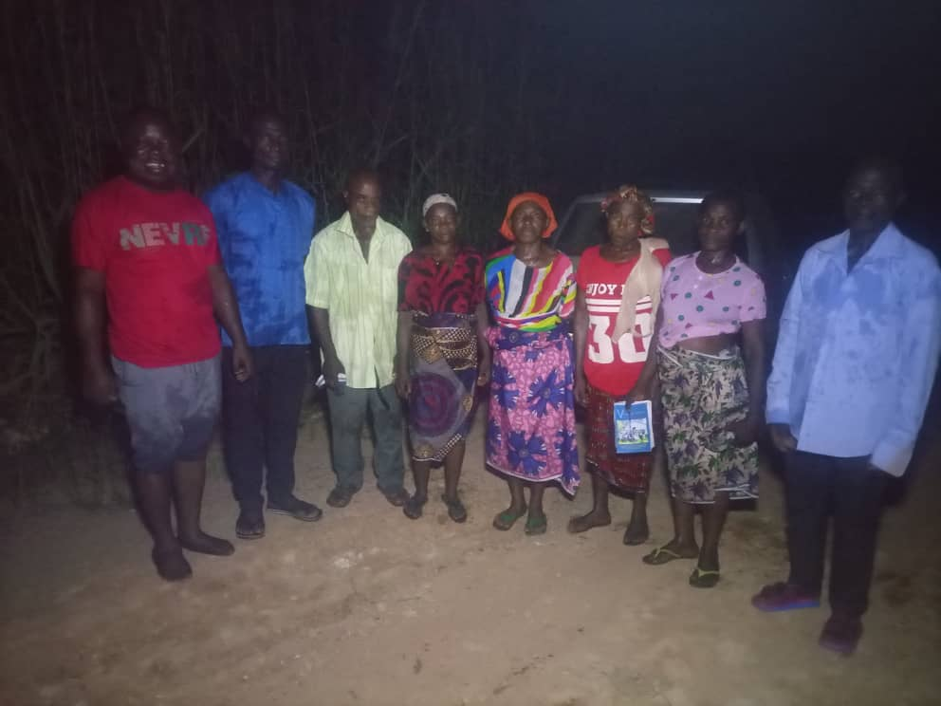
EVANGELISM AT ALLADIM
MIKE UDAM WITH THE NEWLY BAPTISED BRETREN

Slide 7
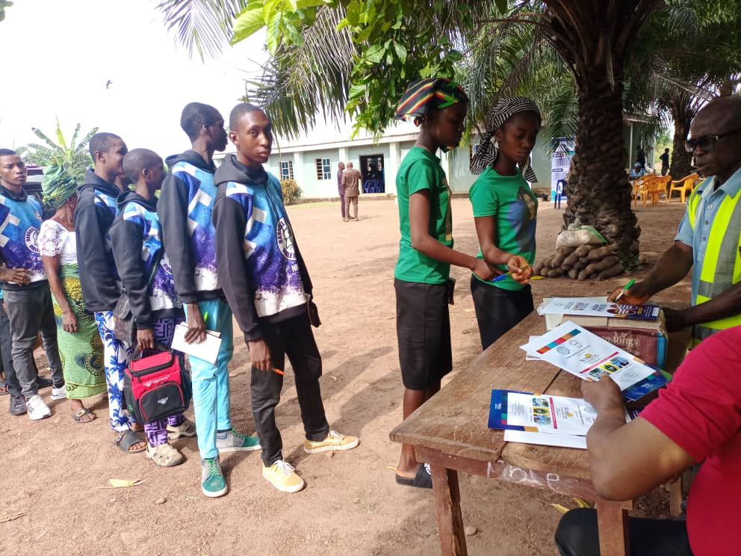
INDOOR LECTURESHIP AT UKPAGADA
REGISTRATION DESK FOR PARTICIPANTS

Slide 8
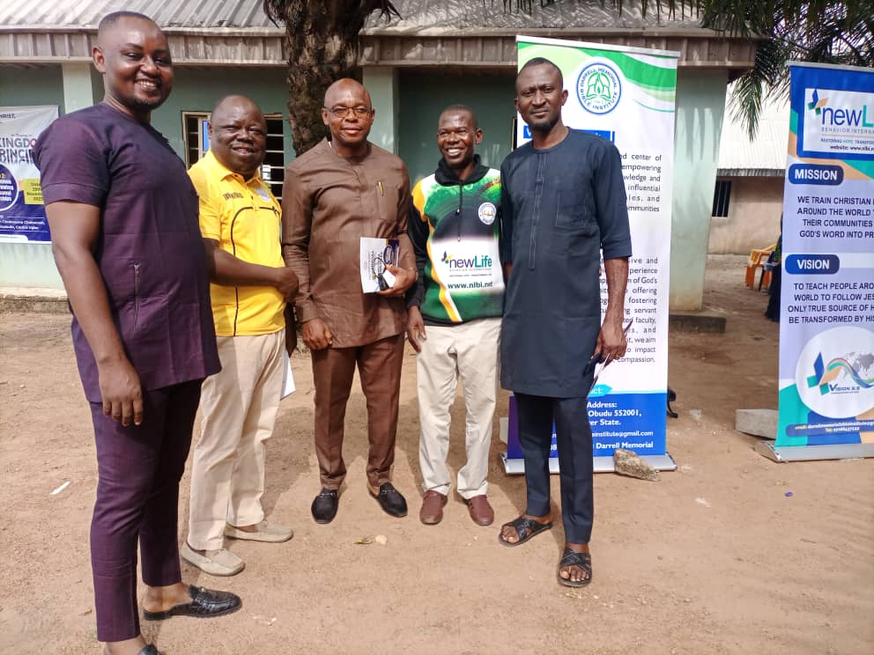
INDOOR LECTURESHIP AT UKPAGADA
EARLY BIRDS

Slide 9
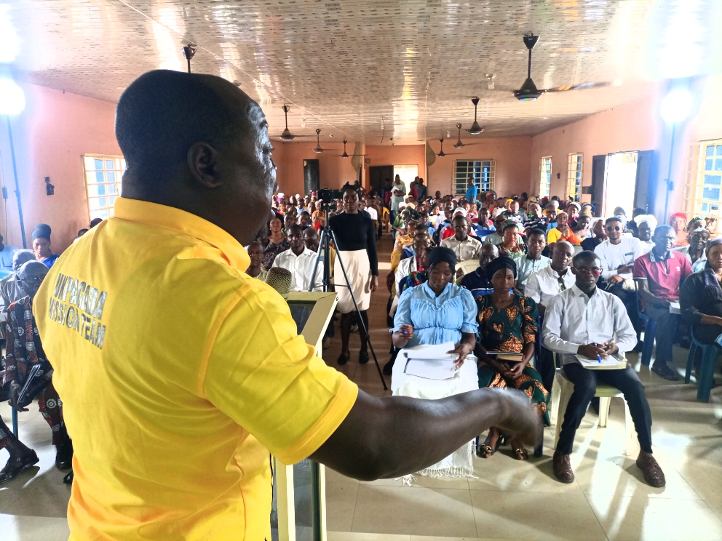
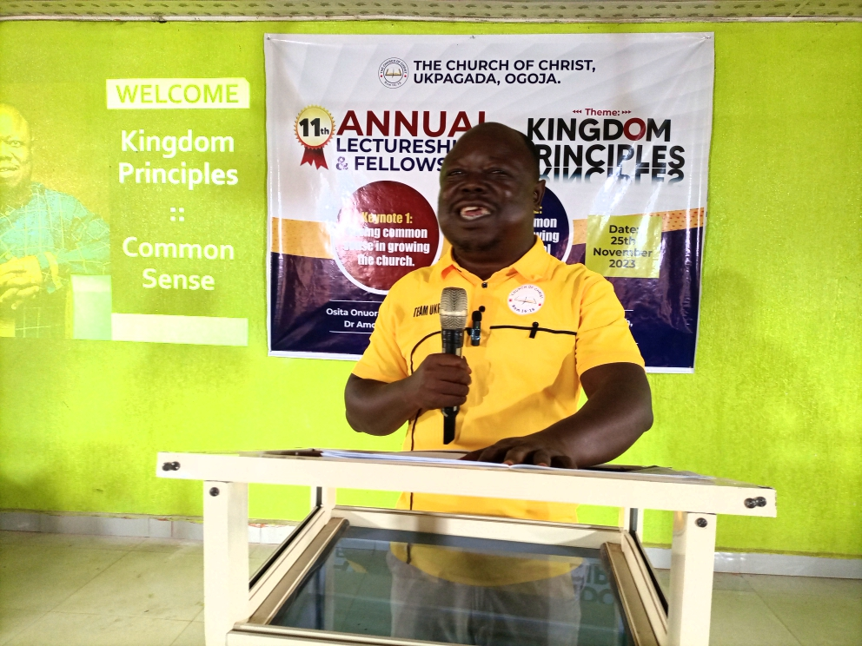
INDOOR LECTURESHIP AT UKPAGADA
PRESENTING THE THEME ANALYSIS

Slide 10
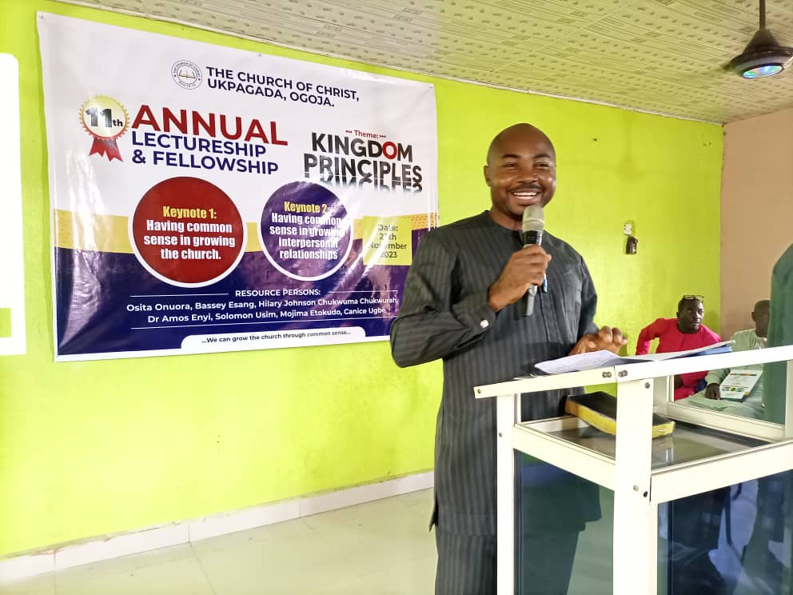
INDOOR LECTURESHIP AT UKPAGADA
Dr. Amos Enyi presenting Keynote 1

Slide 11
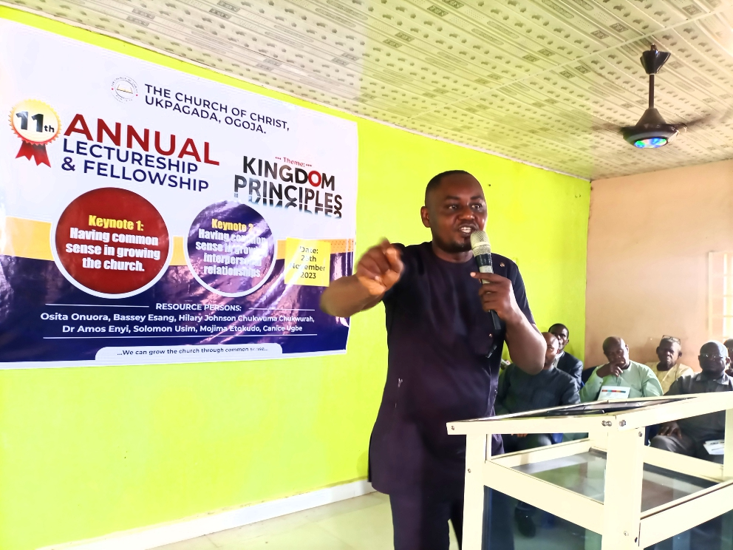
INDOOR LECTURESHIP AT UKPAGADA
Solomon Usim presenting Keynote 2

Slide 12
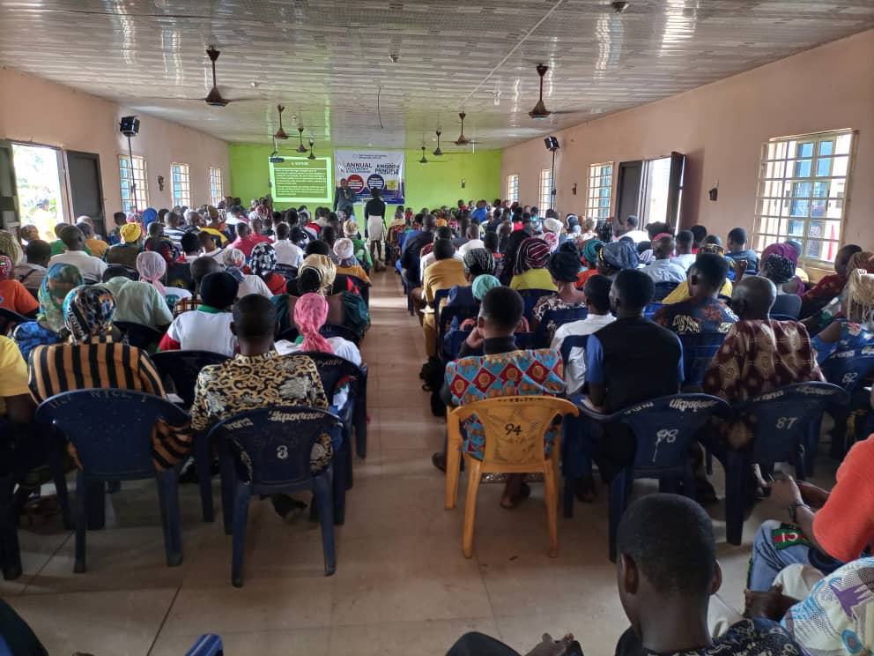
Cross section of participants

Slide 13
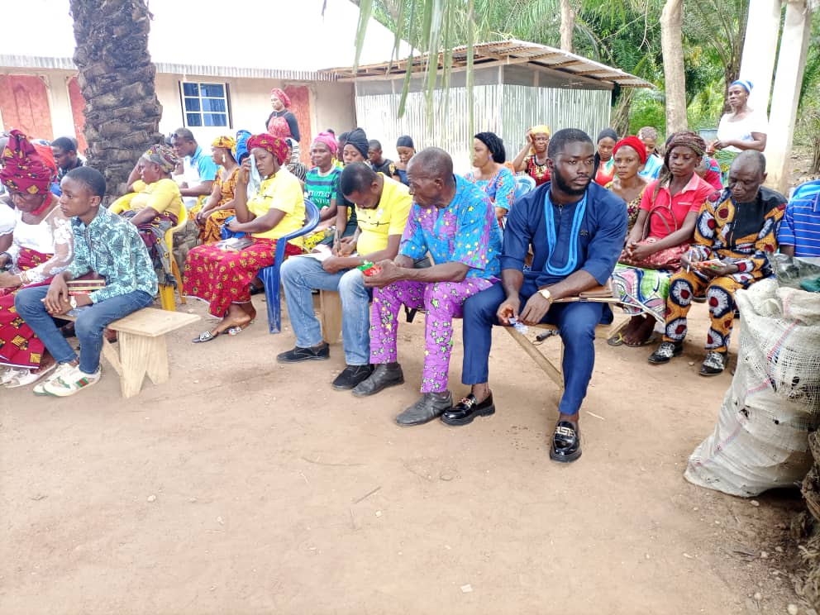
Cross section of participants who could not get a space inside.

Slide 14
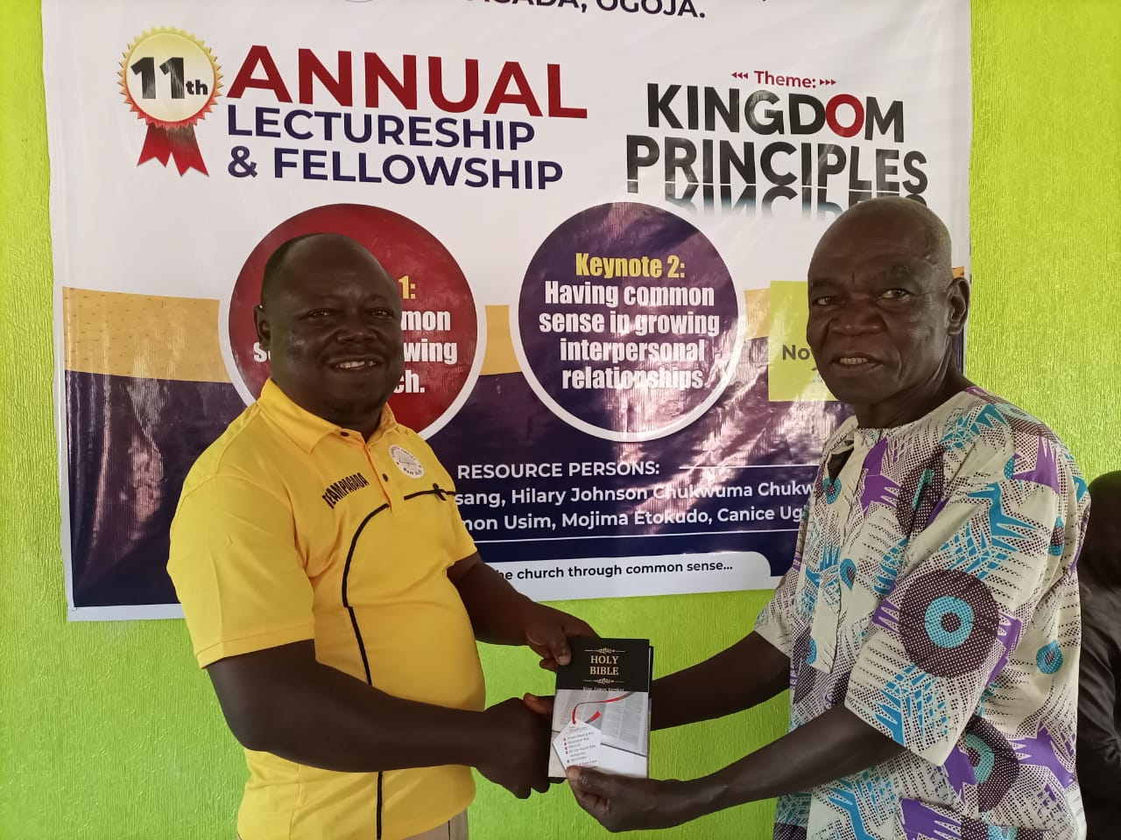
Presentation of Bible of the One Soul who was baptized during the indoor lectureship

Slide 15
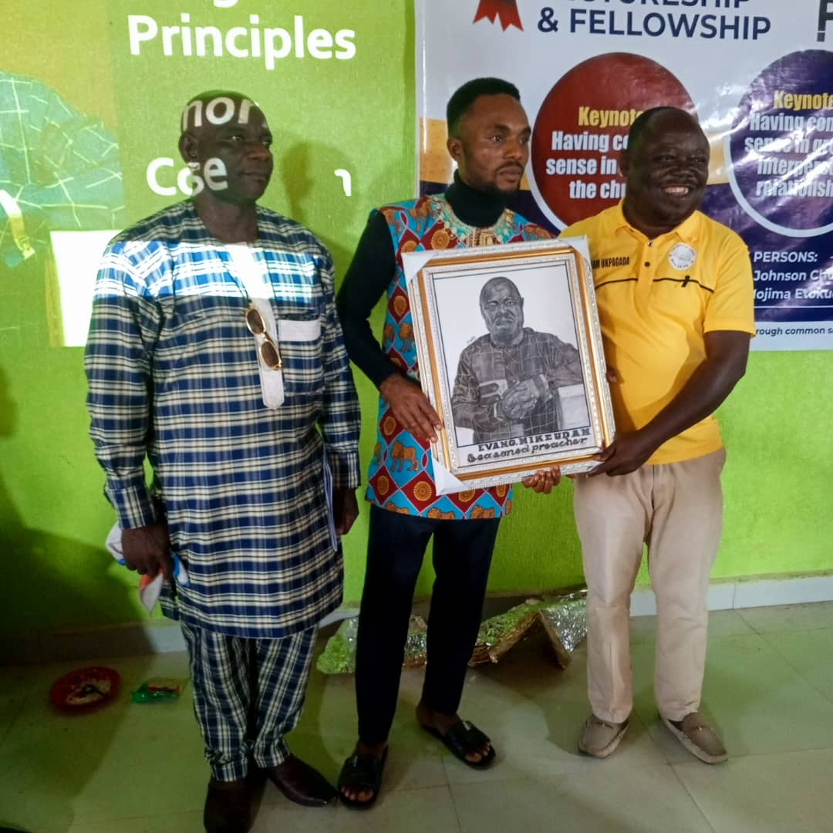
Presentation of a portrait of me during the lectureship

Slide 16
Closing Remarks
The lectureship created the avenue for brethren to learn more about doing the things of God in the ways of God.
The support from the Thorntons was handy to make the programme a huge success.
Our expenses on motels was cut down because our Mission House was completed and put to immediate use.
We will request for support going forward because of the rising cost of living and it’s impact on the church.

